Slide 1
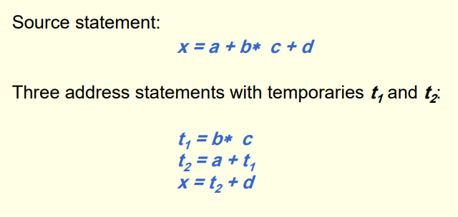
Compiler
3 address code

Slide 2
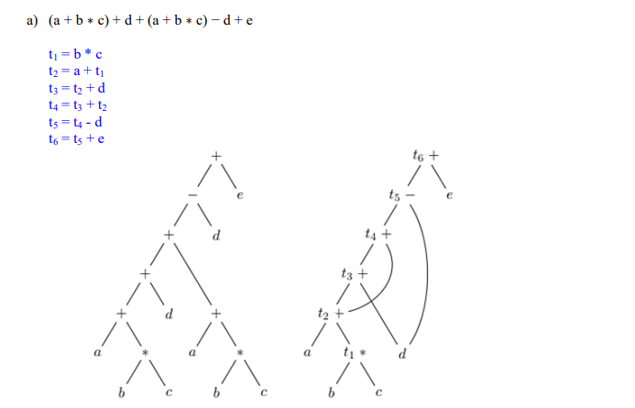
Compiler
3 address code

